Slide 1

Social Media Analytics for Emergency Response Module – An iHELP Component
Prepared by:
Alaa’ Mazen Al-Aghbar
Hajer Mahmoud Qasem
Nermeen Ghassan Al-Zayed
Supervised by:
Dr. Sufyan Al-Majali
Dr. Salam Fraihat

Slide 2
What is iHELP?

Slide 3
The following modules need to be developed to make iHELP usable in practice:
1) User Interface for Route Animation using Google Maps and Logistics Information Dashboard
2) Data Input Module
3) Social Media Analytics Module
4) Volunteer Management Module.
In our project, we will be mainly focusing on the Social Media Analytics Module where we will text-mine logs from social media outlets such as Twitter.

Slide 4
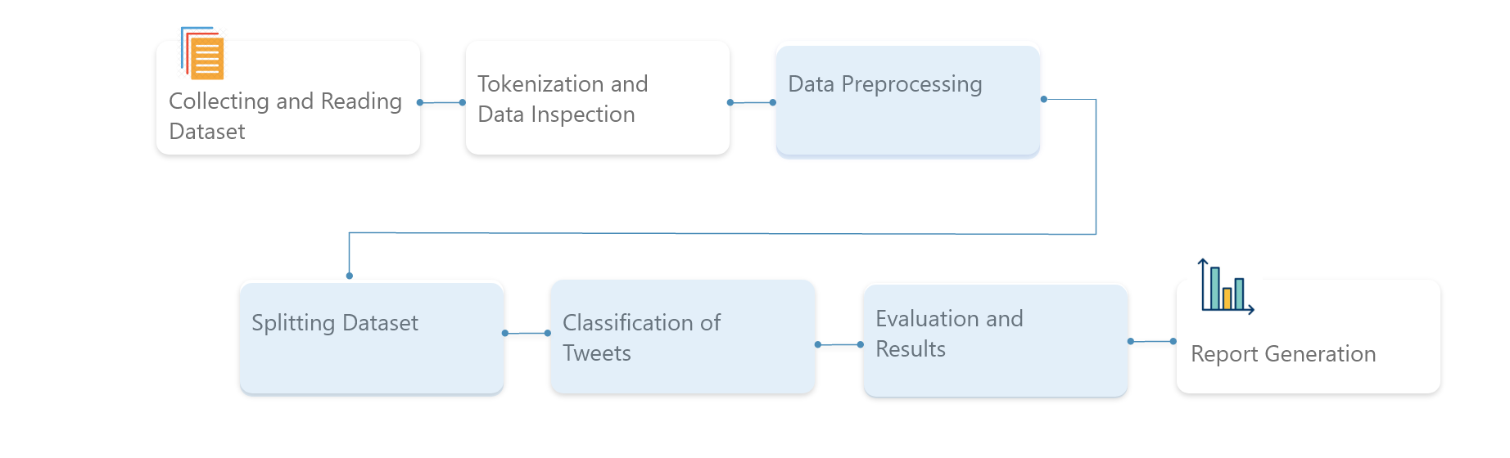
Project Workflow

Slide 5
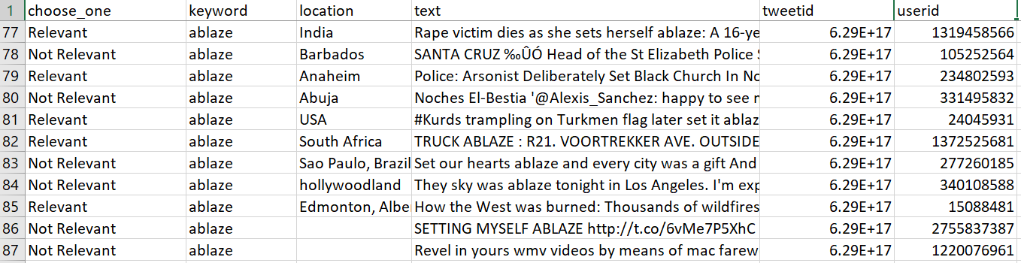
Collecting and Reading Dataset
We collected over 10,000 crisis-related tweets from Twitter posted from August to September in 2015 through Figure8.

Slide 6
Tokenizing
Tokenization is a step which splits longer strings of text into smaller pieces, or tokens. Larger chunks of text can be tokenized into sentences, sentences can be tokenized into words, etc.
For our task, we will tokenize our sample text into a list of words. This is done using NTLK's RegexpTokenizer() function.

Slide 7
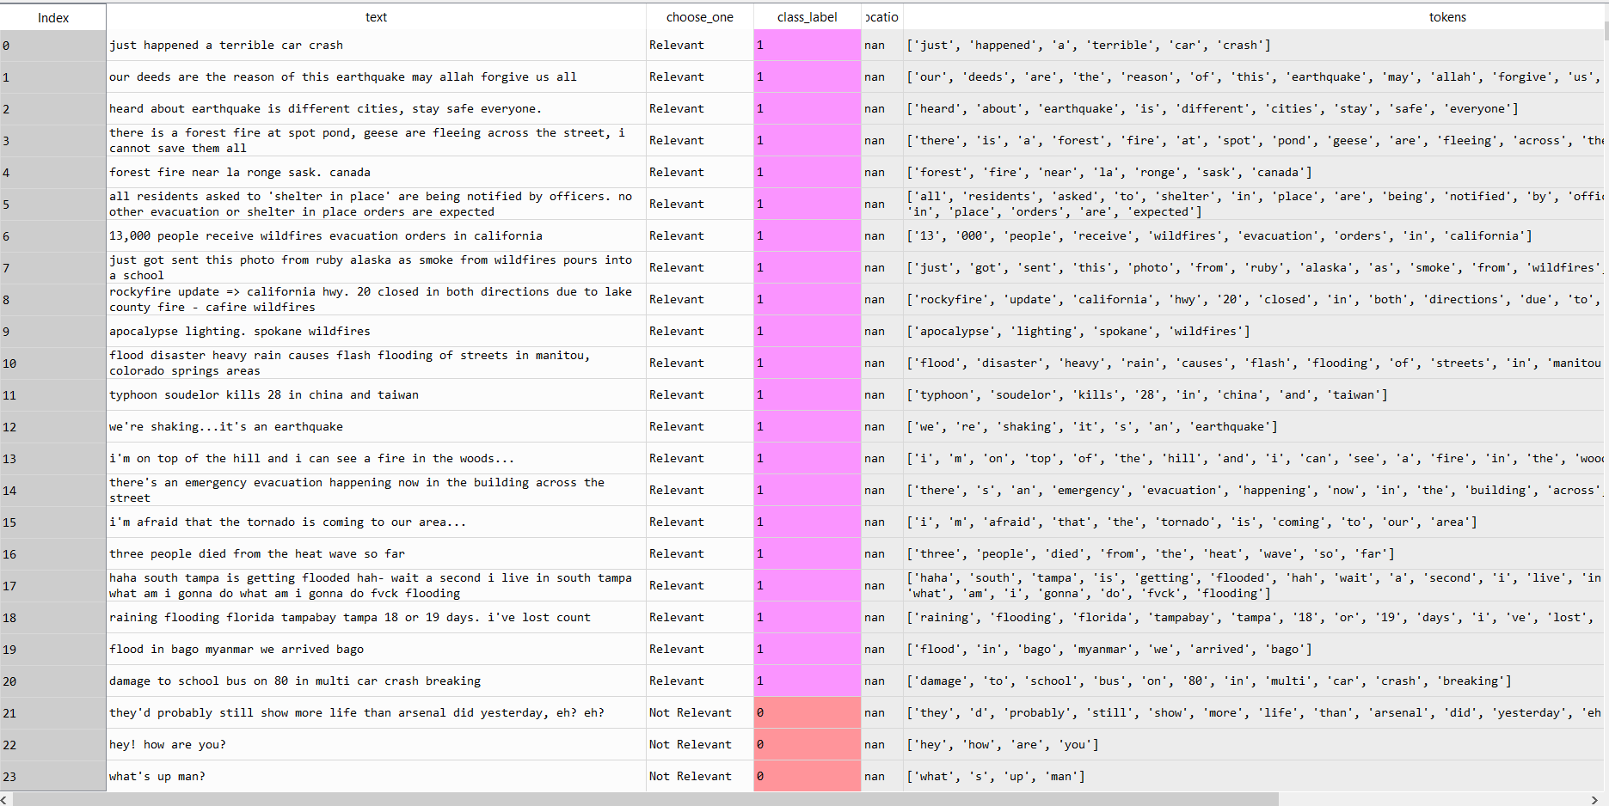

Slide 8
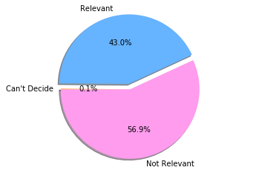
Data Inspection

Slide 9
Data Preprocessing
Feature Engineering
Cleaning
Dataset
Feature Extraction/ TF-IDF

Slide 10
Data Preprocessing – Feature Engineering
Feature engineering is the method of converting raw data into features that improve representation of the underlying problem to the predictive models, ensuing enhanced model accuracy on test data.
To realize this, we first represented our csv file in a dataframe format, we also introduced a new feature by adding a column named “class label”. In this column we sorted our data into 3 groups based the “choose one” (relevancy) column where “1” represents “Relevant”, 0 represents “Not relevant” and “2” is for “Can’t decide”.
Next, we extracted columns “text”, “choose one”, “class label”, “location” and placed them into our dataframe for later use.

Slide 11
Data Preprocessing - Cleaning Data
This step preprocesses the tweet content before creating the numeric vector. This task removes the tweets which contain any links or special characters from collected tweets. Finally, all text is converted to lower case.

Slide 12
Data Preprocessing – Feature Extraction/TF-IDF
To make sense of huge amounts of collected Twitter text, we consider a basic operation, that is to transform the text into some numeric or vector representation. This numeric representation should illustrate important characteristics of the text. There are many such techniques, in this project we use TF-IDF (Term Frequency, Inverse Document Frequency) which means weighing words by how frequent they are in our dataset, disregarding words that are too frequent (the, of ..etc.), as they just add extra noise.

Slide 13
TF-IDF algorithm transforms text into a meaningful representation of numbers, which is widely used to extract features across various NLP applications.
Term frequency of a word is defined as the ratio of count of the word in the document to total number of words in the document. It measures how frequently a term (word) occurs in a document.
tf(w) = doc.count(w)/total words in doc
Inverse document term frequency measures how important a term (word) is.
idf(w) = log(total number of documents/number of documents containing word w)
TF-IDF is the product of term-frequency and inverse document frequency.
Tf-idf(w) = tf(w)*idf(w)TF-IDF based representations help in empowering the NLP algorithms which have huge applications in today's world.

Slide 14
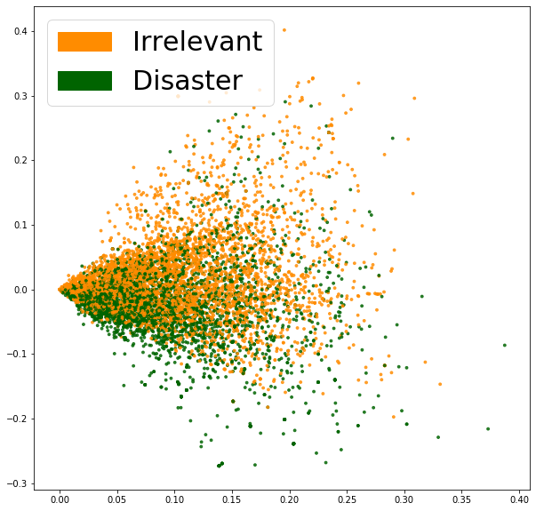
Data Distribution (1)

Slide 15
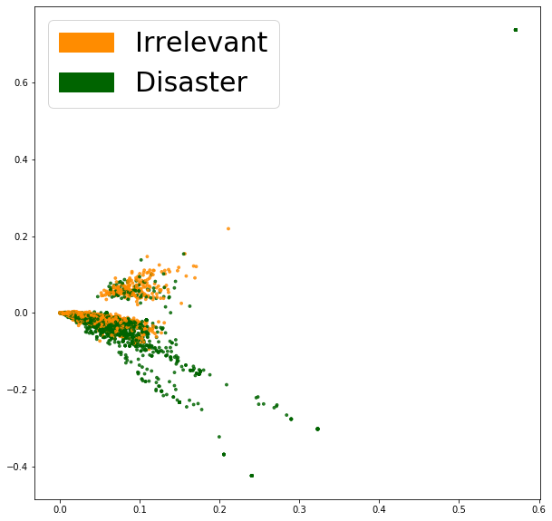
Data Distribution (2)

Slide 16
Classification of Tweets – Logistic Regression
This classifies as multiclass categorization problem in which cases are categorized into one of several classes. Specifically, we aim at learning a predictor h : X → Y, where X is the set of tweet text and Y is a finite set of categories. For this purpose, we use Logistic Regression for its simplicity, and is ease of interpretation.

Slide 17
 |  | Predicted
 |  | Positive | Negative
Actual | Positive | 1024 (TP) | 374 (FN)
 | Negative | 325 (FP) | 1534 (TN)
Precision – Accuracy of positive predictions.
Precision = TP/(TP + FP)
Recall: Fraction of positives that were correctly identified.
Recall = TP/(TP+FN)
F1 Score: Percent of positive predictions that are correct.
F1 Score = 2*(Recall * Precision) / (Recall + Precision)

Slide 18
Evaluation and Results

Slide 19
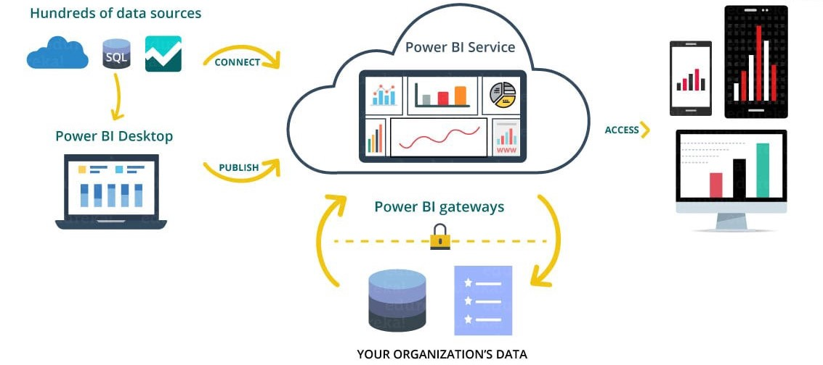
Report Generation

Slide 20
Future Work

